Slide 1




Slide 2
Beam Search Decoding

Slide 3
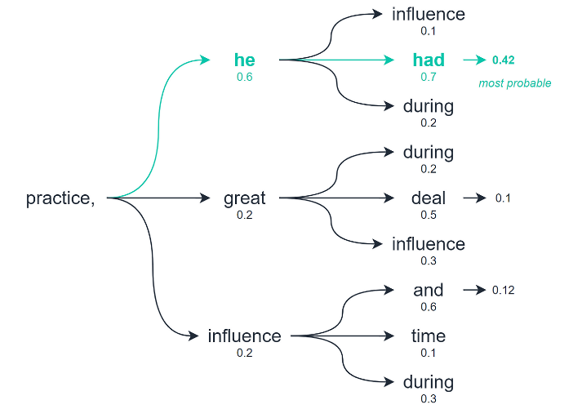
Recap
Greedy search decoding is a simple and efficient algorithm.
It is also easy to implement and understand.
Greedy Search Decoding Limitation:
can sometimes produce suboptimal results
not consider the probability of the entire output sequence
https://towardsdatascience.com/the-three-decoding-methods-for-nlp-23ca59cb1e9d
Notes:
Hello and welcome to this video , where we will learn about beam search decoding , last video we have learned about greedy search decoding which is a simple and efficient algorithm. It is also easy to implement and understand. However, Greedy Search Decoding can sometimes produce suboptimal results. This is because the decoder only considers the probability of the next token, and it does not consider the probability of the entire output sequence.
To address the limitations of Greedy Search Decoding use can use Beam Search Decoding is a more complex algorithm.

Slide 4
Beam Search Decoding
Beam Search Decoding: considers the probability of the entire output sequence, and it keeps track of multiple possible output sequences.
Beam Search Decoding to produce more accurate results than Greedy Search Decoding.
great
example
a
lot
toy
the
most
popular
toys
are
not
desired
toys
Transformers
have
will
be
released
on
May
have
been
in
theaters
Notes:
Beam Search Decoding considers the probability of the entire output sequence, and it keeps track of multiple possible output sequences. This allows Beam Search Decoding to produce more accurate results than Greedy Search Decoding

Slide 5
How it works?
Keeping track of a beam of possible output sequences
great
example
a
lot
toy
the
most
popular
toys
are
not
desired
toys
Transformers
have
will
be
released
on
May
have
been
in
theaters

Slide 6
How it works?
Keeping track of a beam of possible output sequences
great
example
a
lot
toy
the
most
popular
toys
are
not
desired
toys
Transformers
have
will
be
released
on
May
have
been
in
theaters

Slide 7
How it works?
Keeping track of a beam of possible output sequences
The beam is a set of the top-b most probable output sequences at each time step.
great
example
a
lot
toy
the
most
popular
toys
are
not
desired
toys
Transformers
have
will
be
released
on
May
have
been
in
theaters

Slide 8
How it works?
Keeping track of a beam of possible output sequences
The beam is a set of the top-b most probable output sequences at each time step.
The decoder then chooses the sequence with the highest probability at each time step.
The process is repeated until:
reach the maximum length
EOS token
great
example
a
lot
toy
the
most
popular
toys
are
not
desired
toys
Transformers
have
will
be
released
on
May
have
been
in
theaters

Slide 9
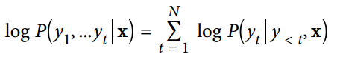
How ranking the b beams ?
the most likely sequence is selected by ranking the b beams according to their log probabilities.
Using log probabilities Pros:
Avoid numerical instability → the calculation of the overall probability of a sequence involves calculating a product of conditional probabilities which is typically a small number in the range from 0 to 1
lead to the overall probability to underflow

Slide 10
Comparison between greedy and beam search
Calculate and compare the log probabilities of the texts generated by greedy and beam search:
Get the total log probability of a sequence :
import torch.nn.functional as F
def log_probs_from_logits(logits, labels):
# normalize the logits to create a probability distribution over the whole vocabulary for each token in the sequence.
logp = F.log_softmax(logits, dim=- 1)
# select only the token probabilities that were present in the sequence.
logp_label = torch.gather(logp, 2, labels.unsqueeze(2)).squeeze(-1)
return logp_label
def sequence_logprob(model, labels, input_len=0):
with torch. no_grad():
output = model(labels)
log_probs = log_probs_from_logits(output.logits[:, : - 1, :], labels[:, 1:])
seq_log_prob = torch.sum(log_probs[:, input_len:])
return seq_log_prob.cpu().numpy()

Slide 11
Comparison between greedy and beam search
Calculate the sequence log probability of the greedy decoder:
import torch
from transformers import AutoTokenizer, AutoModelForCausalLM
device = "cuda" if torch. cuda. is_available() else "cpu"
model_name = "gpt2-xl"
tokenizer = AutoTokenizer. from_pretrained(model_name)
model = AutoModelForCausalLM. from_pretrained(model_name).to(device)
max_length = 128
input_txt = """In a shocking finding, scientist discovered \
a herd of unicorns living in a remote, previously unexplored \
valley, in the Andes Mountains. Even more surprising to the \
researchers was the fact that the unicorns spoke perfect English. \n\n
"""
input_ids = tokenizer(input_txt, return_tensors="pt" )["input_ids" ].to(device)
output_greedy = model.generate(input_ids, max_length=max_length, o_sample=False)
logp = sequence_logprob(model, output_greedy, input_len=len(input_ids[0]))
print(tokenizer.decode(output_greedy[0]))
print(f" \nlog-prob: {logp:.2f}" )
The researchers, from the University of California, Davis, and the University of Colorado, Boulder, were conducting a study on the Andean cloud forest, which is home to the rare species of cloud forest trees.
The researchers were conducting a study on the Andean cloud forest, which is home to the rare species of cloud forest trees.
The researchers were conducting a study on
log-prob: -68.37

Slide 12
Comparison between greedy and beam search
2. Calculate the sequence log probability of the beam decoder:
output_beam = model. generate(input_ids,
max_length=max_length,
num_beams=5,
do_sample=False)
logp = sequence_logprob(model, output_beam, input_len=len(input_ids[0]))
print(tokenizer. decode(output_beam[0]))
print(f" \nlog-prob: {logp:.2f}" )
In a shocking finding, scientist discovered a herd of unicorns living in a remote, previously unexplored valley, in the Andes Mountains. Even more surprising to the researchers was the fact that the unicorns spoke perfect English.
According to the researchers, the unicorns were found in a remote valley in the Andes Mountains in Peru. The valley is located in a remote area of the Andes Mountains. The valley is located in a remote area of the Andes Mountains. According to the researchers, the unicorns were found in a remote valley in the Andes Mountains in Peru. The valley is located in a remote area
log-prob: -44.86

Slide 13
Comparison between greedy and beam search
Address repetitive sequence:
output_beam = model.generate(input_ids,
max_length=max_length,
num_beams=5,
do_sample=False,
no_repeat_ngram_size=2)
logp = sequence_logprob(model, output_beam, input_len=len(input_ids[0]))
print(tokenizer.decode(output_beam[0]))
print(f" \nlog-prob: {logp:.2f}" )
In a shocking finding, scientist discovered a herd of unicorns living in a remote, previously unexplored valley, in the Andes Mountains. Even more surprising to the researchers was the fact that the unicorns spoke perfect English.
The researchers, from the University of California, Los Angeles (UCLA) and the Universidad Nacional Autónoma de México (UNAM) in Mexico City, discovered the unicorn herd by accident. They were conducting a study on the effects of climate change on wild animals, when they came across the herd.
"When we first saw them, we couldn't believe our
log-prob: -77.14

Slide 14
Summary
Beam search with n-gram penalty is a good way to find a trade-off between focusing on high-probability tokens while reducing repetitions.
Beam search with n-gram penalty used in applications such as summarization or machine translation where factual correctness is important.
When factual correctness is less important than the diversity of generated output, for instance in open-domain chitchat or story generation.
Another alternative to reduce repetitions while improving diversity is to use sampling.

